Slide 1
Internet Databases

Slide 2
What do databases have to do with the internet?

Slide 3

Enormous amount of information
Web Page
Web pages
Create
Read
Update
Delete
Web servers
Web servers
How does the information travel ?
How to decide which information to get?

Slide 4
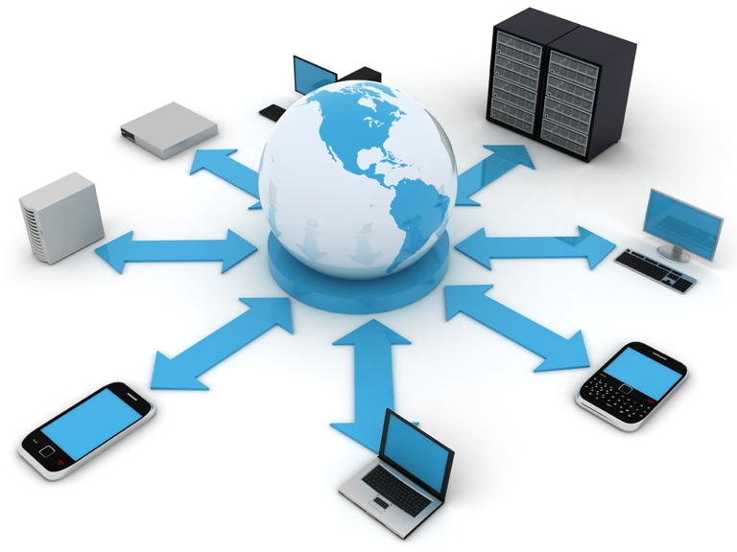
Serialization
Storing and transmitting data structures and reconstructing them later.

Slide 5
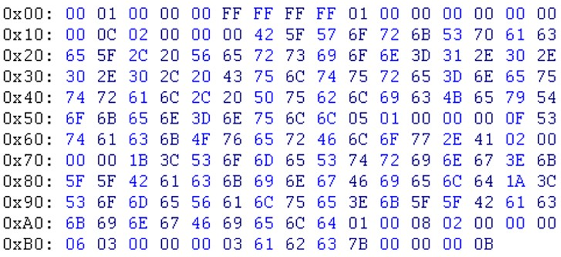

Slide 6
Serialization
Storing and transmitting data structures and reconstructing them later.
XML
  A human readable text-based encoding

Slide 7
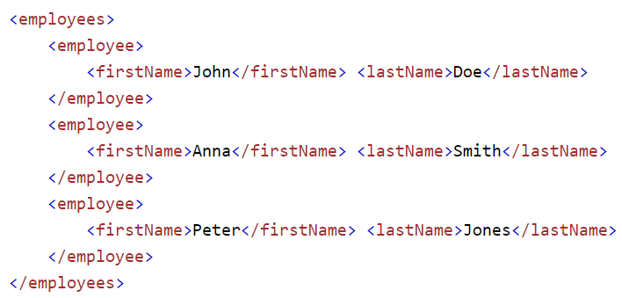

Slide 8
Serialization
Storing and transmitting data structures and reconstructing them later.
XML
  A human readable text-based encoding
JSON
  A lighter plain-text alternative to XML

Slide 9
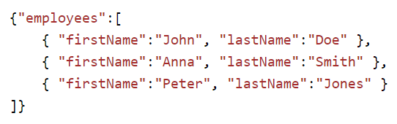

Slide 10
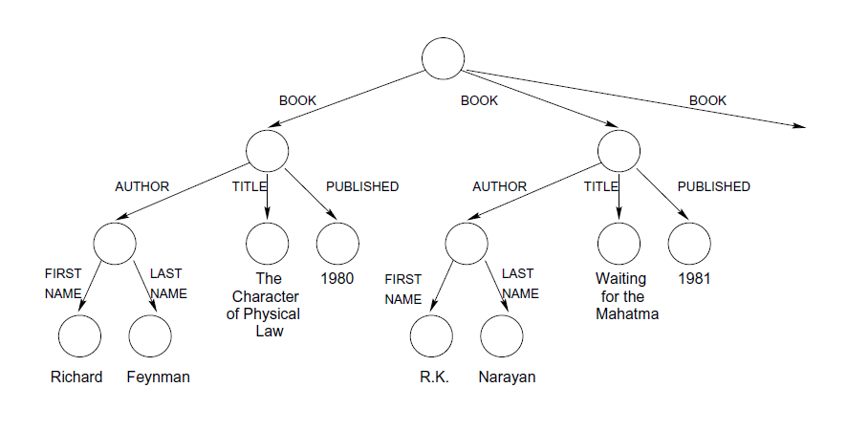
Semi-Structured Data Model
Self-describing structure
Nodes -> compound objects or atomic values
Edges -> attributes

Slide 11
XML and JSON are used by web services to encode and decode data.
Exchanging data between a web browser and a web server.
What problem does it solve?

Slide 12
How does the information travel ?
How to decide which information to get?

Slide 13
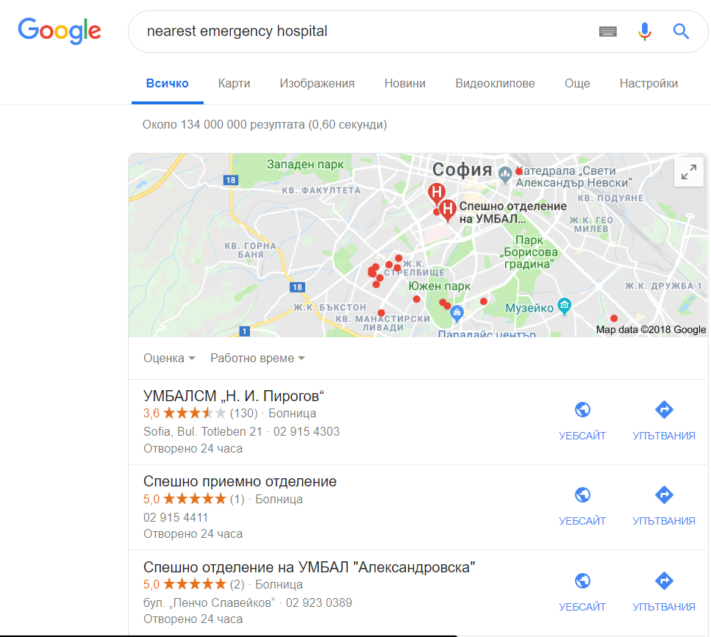
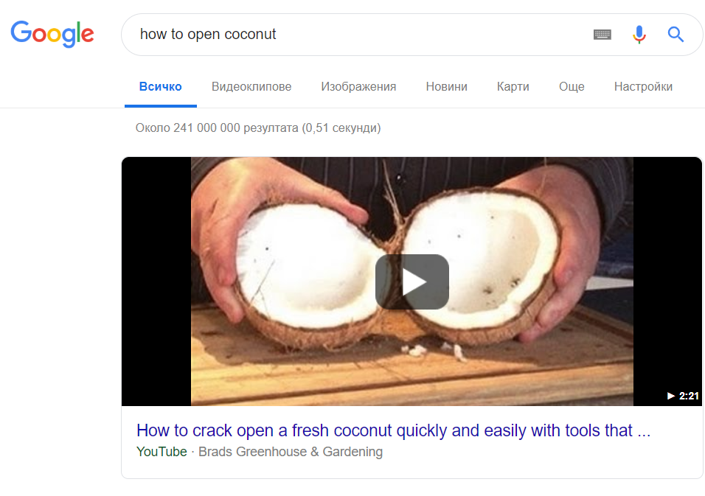
Text Search
Queries

Slide 14
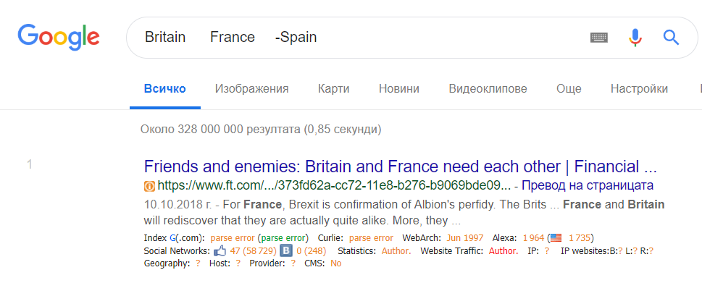
Text Search
Boolean query
The result:
Documents that involve the concepts in the query.
^
^

Slide 15
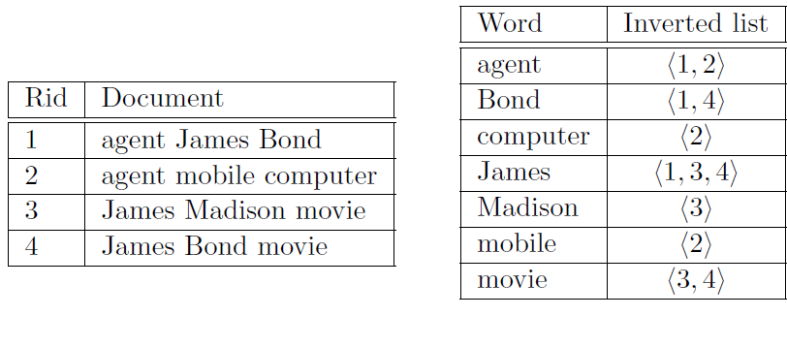
Inverted Files
Ordered List
B+ tree
Fast retrieval of all documents that contain a query term.

Slide 16
Inverted Files
1, 4
James Bond

Slide 17
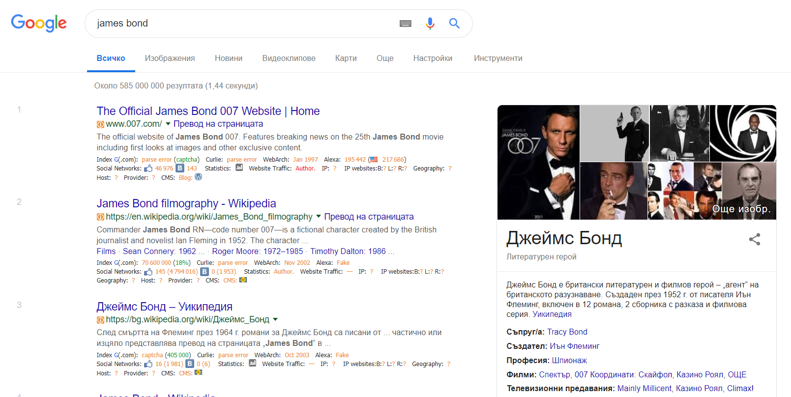
Text Search
Ranked query
The result:
Documents ranked by their relevance to the list of user terms.

Slide 18
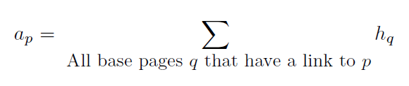
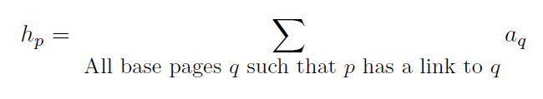
HITS
Authority: page very relevant to a topic
Hub: page with a hyperlink to an authority
Authority weight: the quality of a page as a authority
Hub weight: the quality of a page as a hub
All weights are initialized to 1 and then updated iteratively

Slide 19
Questions?

